Slide 1

Question/Answering System for Diseases
Gupta, Arunit – 11
Patel, Marmikkumar Navinchandra – 31
McDuff, Luke Joseph – 21
Ejjirothu, Manoj Prabhakar – 7

Slide 2

MOTIVATION
Information today moves at a very high rate of speed with sources as Twitter and other social media. We are able to get info immediately but it is difficult to filter and provide meaningful representations of the data. Our motivation is to provide the user the ability to Question the system which could apply machine learning and natural language processing techniques to retrieve meaningful answers about diseases through on top of large dataset.

Slide 3

OBJECTIVE
To Create a Question and Answering System that could intelligently answer questions about diseases that can provide uses with information that is valuable to them.

Slide 4
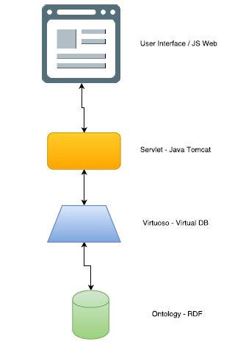
ARCHITECTURE

Slide 5
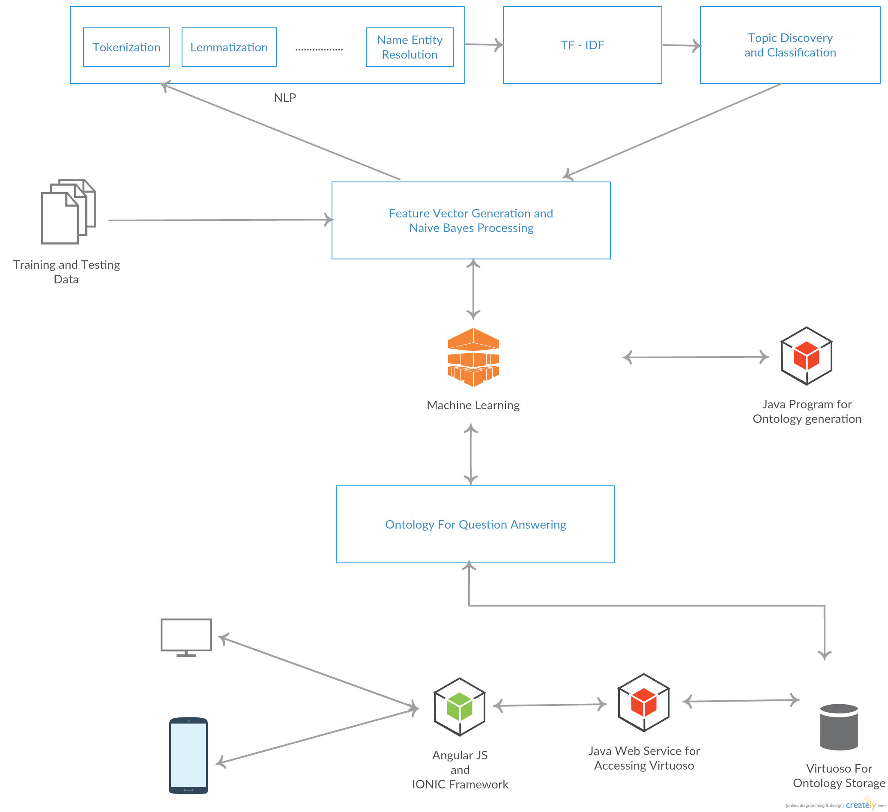
APPROACH

Slide 6
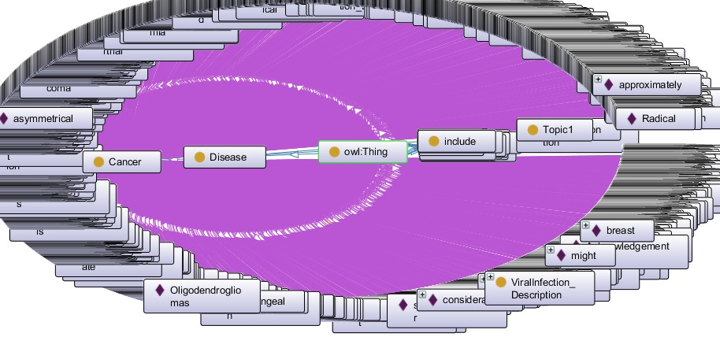
ONTOLOGY

Slide 7
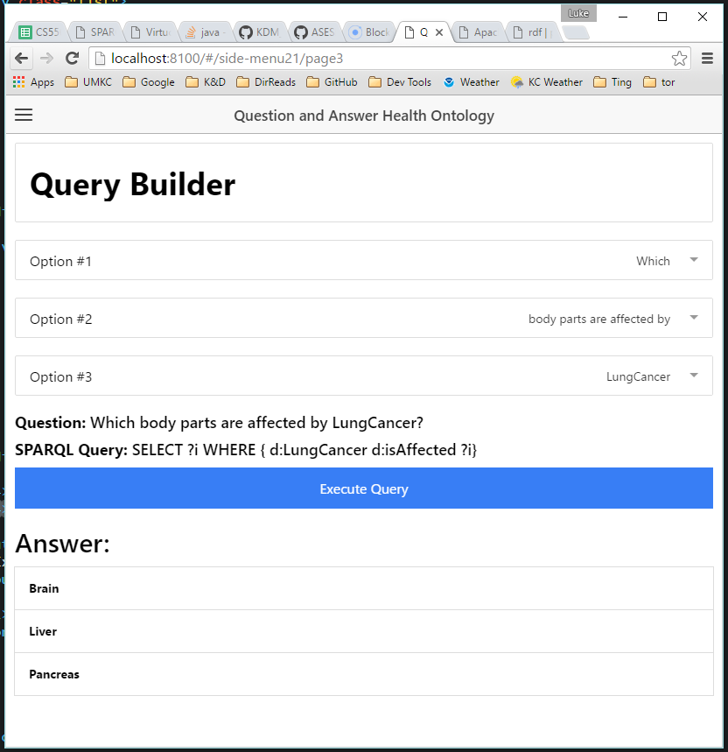
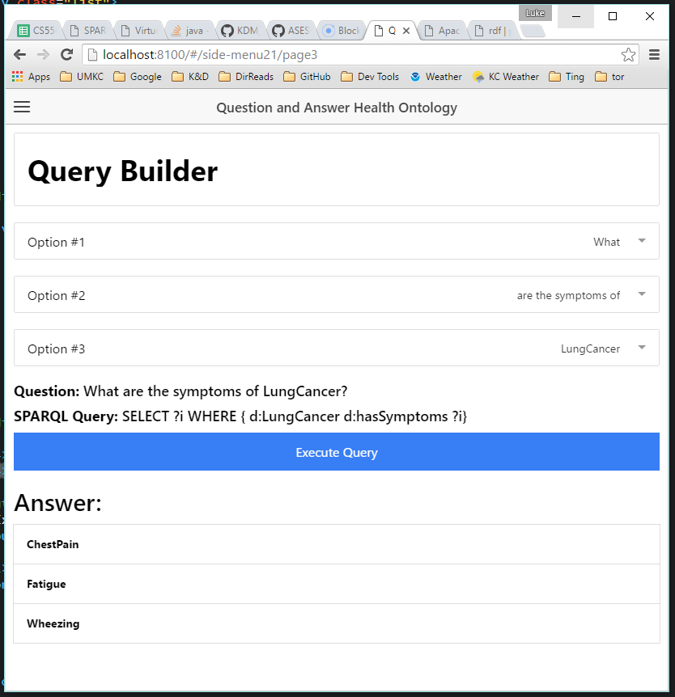
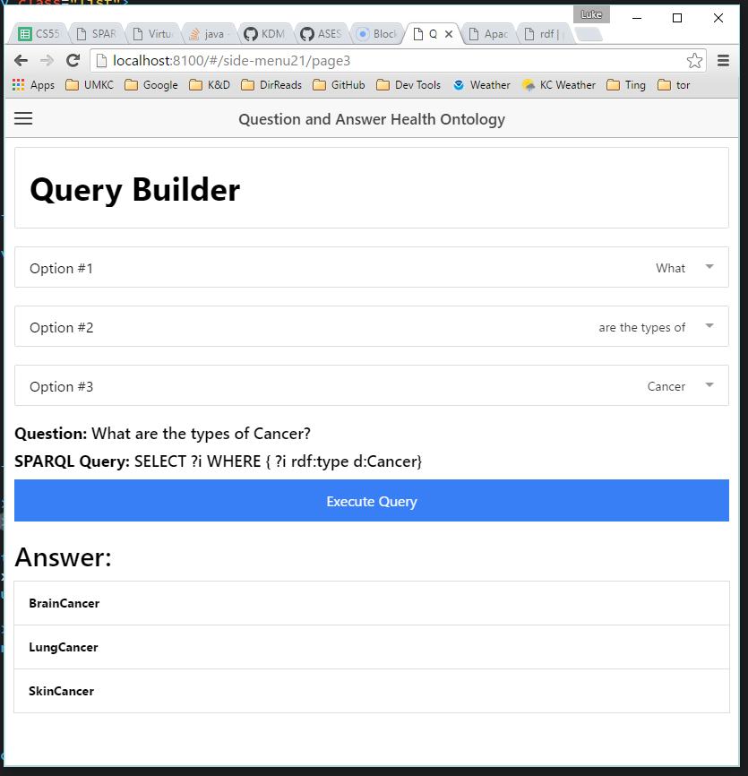
RESULTS/EVALUATION

